Slide 1
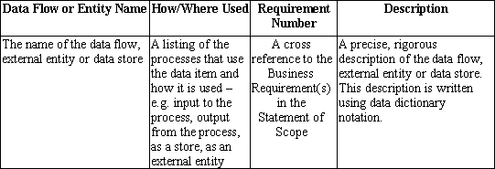
The Minimum Contents of the
Data Dictionary
Not shown are the cross-referencing columns, which are also mandatory.
Notes:
Other fields could be:
Other fields could be used to keep track of the location/completion of :
DFD Process Number
ERD Model
TSD Model
For each Data Flow/Entity Name

Slide 2
More on Data Stores
Processes read data as output from a data store.
Processes create, update or delete as input to a data store.
If a data store is created by the system and only used by the system, then the data store is modeled internal to the system and appears only on level 1 and below DFDs wherever it is accessed by the system.
If a data store is used by the system (i.e. not created by the system), or if the data store is created by the system, and used by other systems as well as this system, then the data store is modeled external to the system. An external data store appears only on a level 0 DFD (Context Diagram). Data flow from/to the external data store is annotated as inputs to and/or outputs from the system.
Notes:
Teach basis DFD Level 0 and Level 1..n modeling now. Include both external data stores on level 0, and internal data stores on level 1..n

Slide 3
Internal Data Store Example
(Diagram is not complete)
Sensor Number
5
-----
Generate
Sensor
Report
Sensor Report
A read
Report Name
Sensor Information
Sensor Status
Data store is not used by any external entities/actors, and there is bi-directional data flow present. Therefore, data store is internal to the system.
Sensor Information Store
6
-----
Monitor
Sensors
Sensor Information
An update

Slide 4
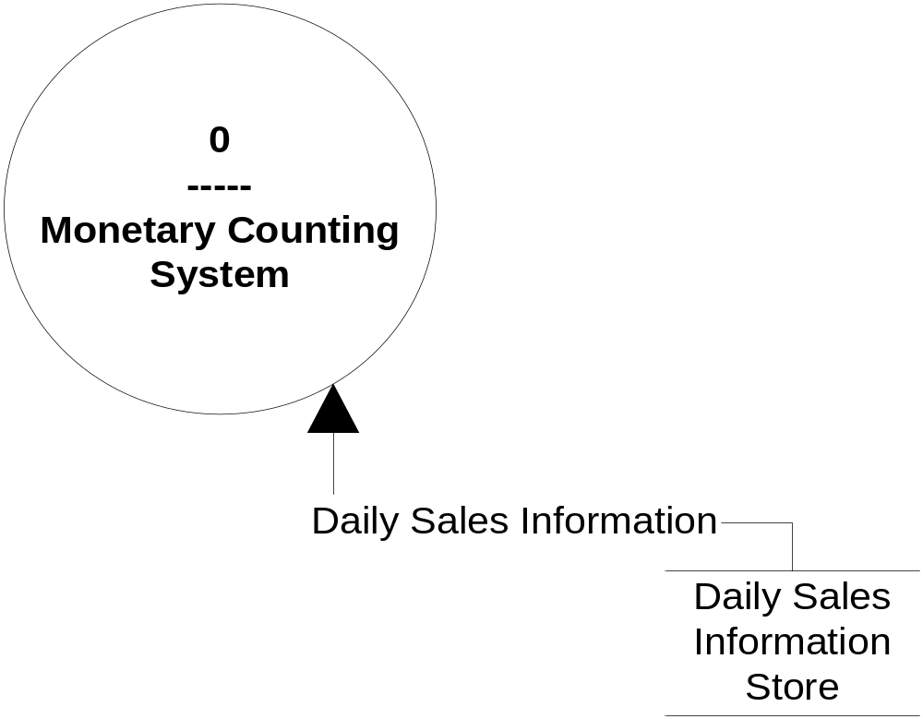
External Data Store Example
(Diagram is not complete
– there are more data flows on Context Diagram)
A read only data store
Data is created, updated, deleted by another system. Therefore, data store is external to the system.
As long as the data store is used by any other system, then the data store is modelled as being external to the system, and thus “visible” to other systems.

Slide 5
Interesting Observation!
There are at least four ways to start analysis:
Create Use-Cases/TSDs, then DFDs, then ERDs.
Create DFDs, then Use-Cases/TSDs, then ERDs.
Create ERDs, then DFDs, then Use-Cases/TSDs.
Create each model independently and then come to consensus on what the software must do to meet the business requirements.
In ALL cases, you MUST incrementally populate the Data Dictionary. Do NOT leave this task to the end of the Analysis; otherwise, the QUALITY of your document will probably be very poor!
Notes:
Which order you choose to perform analysis is really a matter of preference. When a project is data intensive, I tend to start with ERDs so that I gain an early understanding of the data; however, when a project “forces” you to discover data, I tend to start with TSDs and/or DFDs.
The fourth method listed generally only works well with a very disciplined team of analysts who keep the Data Dictionary updated in real time – e.g. there is a Data Dictionary repository on-line available to all analysts 24/7.
There is no right or wrong way to start the analysis!

Slide 6


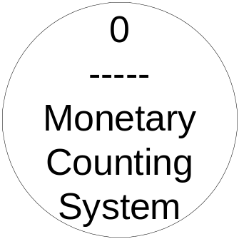


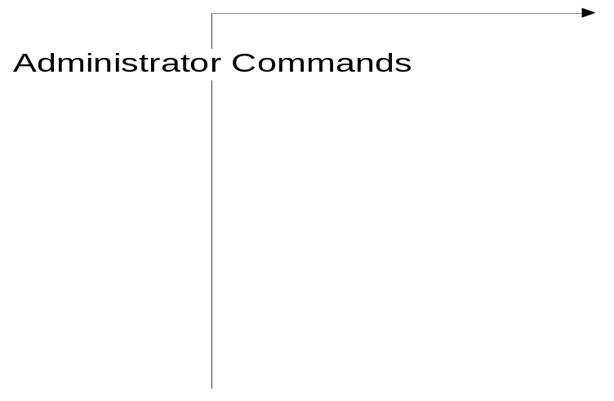


SWE4 The administrator shall be able to create, modify, and delete cashier and administrator accounts.
This is NOT data flow

